Slide 1

The INs and Outs of INpatient Integrated Care
Kelly Roberts, Steven Fillmore, and Shannon Dial

Slide 2

Objectives
Distinguish between integrated behavioral healthcare models in family, specialty, and inpatient medical services;
Map specific opportunity areas within inpatient services requiring special consideration with medical and behavioral health providers;

Slide 3
Objectives, Cont.
Appraise the CNMC inpatient integrated services delivery model and compare to their own medical system; and,
Formulate any beginning steps, midrange development, or more mature revisions for their own integrated inpatient care.

Slide 4
The Chickasaw Nation
  A federally recognized American Indian tribe
  Jurisdictional territory includes more than 7,648 square miles of south-central Oklahoma, encompassing all or parts of 13 counties.
  The Chickasaw Nation population is more than 64,000 citizens, with more than 35,000 living in Oklahoma.

Slide 5
The Chickasaw Nation Health Sites
  Ada – Chickasaw Nation Medical Center (Hospital & Outpatient Services)
  Ardmore, Tishomingo, Purcell – Satellite Clinics

Slide 6
What is Integrated Care?

Slide 7
Integrated Care at the Chickasaw Nation
  Transition to Integrated Care in 2014
  Creation of Medical Family Therapy (BHC Model)
  Certification
  MedFTs work closely embedded in all medical clinics/departments in CNDH

Slide 8
Integrated Care and Tribal Populations
  Realizing the perfect fit
  Bypasses seeking services separately
  Reduction of stigma
  High prevalence of MH concerns
    Impact physical health & vice versa
  Addictions that affect health
  Shared record

Slide 9

Did we have a problem with lack of integrated care?
Only if one considered treatment “non-compliance, worsening somatic morbidity, increased utilization costs, and readmissions…”
Citation: Addressing Psychosomatic Illness in the elderly: Integrated Care Psychiatric Times, November, 2014
Why weren’t they taking their meds?
Why so many outlier days?
And why on earth were they coming back so frequently??

Slide 10
“The Theory of Business,” by Peter Drucker
“The root cause of nearly every one of these crises is not that things are being done poorly. It is not even that the wrong things are being done. Why the paradox? The assumptions on which the organization has been built and is being run no longer fit reality.”
The Peter F. Drucker Reader, page 15
“When a theory shows the first signs of becoming obsolete, it is time to start thinking again, to ask which assumptions fit reality.”

Slide 11
“Think Like A Freak,” by Levitt and Dubner
“People respond to incentives,” page 106
Are we talking about declared preferences or revealed preferences ?????
And are we talking about the providers or the patients…

Slide 12
Was Cialdini right?
Moral incentives may not work as well as we hope…
What influences a patients behavior?
What influences a providers behavior?

Slide 13
What exactly is the issue?
How do I get patients to address the real problem?
How do I get providers to focus on what they do best?

Slide 14
What is a “HOSPITALIST?”
“Another dehumanizing development is the advent (at least in the United States) of “hospitalists,” doctors who practice exclusively in hospitals.” The McDonaldization of Society, Ritzer, page 155
Why won’t “my” doctor be seeing me?

Slide 15
Do I want to be part of assembly line medicine?
The directive to increase predictability may come at the cost of losing the personal touch.
Does this rationality have the unintended consequence of a decline in the quality of medical care?
Is there a correlation between this new way of providing care and our pathetic patient satisfaction scores?

Slide 16
HFMA July 20 Conference
“One barrier is the lack of reliable mechanisms in healthcare settings that ensure patients connect with mental health services.”
“Chronic medical disorders regularly have a behavioral health component.”
“The traditional siloed care models have led to subpar interactions and missed opportunities.”

Slide 17
Why does it take so long to change medical habits?
In 1996, the Institute of Medicine issued a report on primary care that advocated for the integration of behavioral health care to improve patient health.
Our system of “consult Behavioral Health” just wasn’t working.

Slide 18
Who was more frustrated?
Patients?
Providers?
Administrators?
Perhaps it was time to change the paradigm just a bit…

Slide 19
As with any newly formed team, group dynamics are an important factor
Forming, Storming, Norming, Performing
Satire’s Model of Change Toward “New Status Quo”

Slide 20
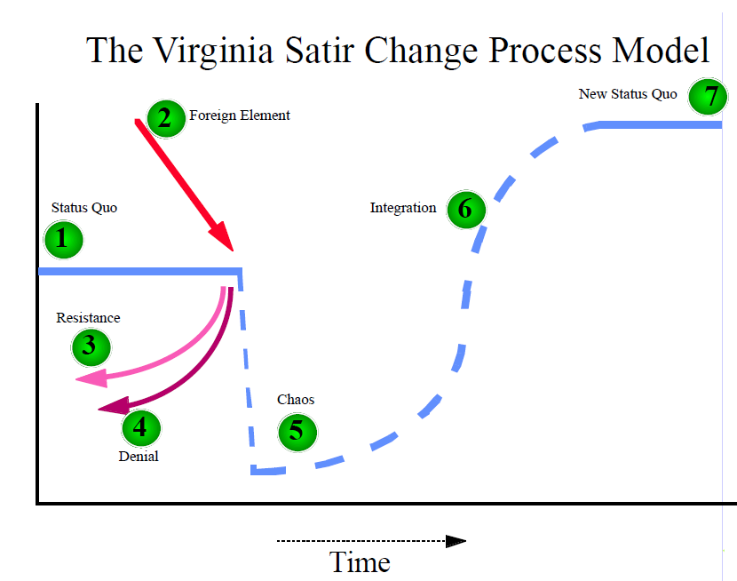

Slide 21

Distinctions Between Systems and Personal Adaptations
Notes:
Residency program inpatient rounding schedules/rhythms
CNMS inpatient service delivery, style, rhythms
Reflect on participants inpatient service delivery, constructs, styles and rhythms

Slide 22
Other MedFT Roles at CNMC
Educator – similar to “journal club” contributions
Consultant – provider/patient communication processes, feedback, dynamics
Peer – provider/provider communication processes, feedback, dynamics

Slide 23
Participant Discussion Section
Dr. Shannon Dial – Identification and assessment of participant systems and opportunities for integrated behavioral health
Dr. Steven Fillmore – Identification and assessment of participant systems and opportunities for inpatient integrated care leadership

Slide 24
Participant Discussion, Cont.
Dr. Kelly Roberts – Identification and assessment of participant systems and opportunities for inpatient integrated care providership/hiring; style and personality of professional that would be most successful in inpatient care settings
Drs. Dial, Fillmore, Roberts – panel of experts facilitating questions of the audience toward their next steps and planning/stages

Slide 25
For more information, contact:
Kelly Roberts, PhD, LMFT – kelly.roberts@chickasaw.net
Steven Fillmore, MD, FACP, MBA – steven fillmore@chickasaw.net
Shannon Dial, PhD, LMFT – shannon.dial@chickasaw.net

